Slide 2
Identify
potential misinformation using a variety of signals
Review
and rate the accuracy of the stories
Lower
Interviewing primary sources
Consulting public data
Conducting analysis of media

Slide 3
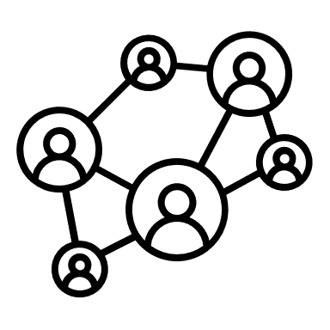




1
Machine Learning algorithms use a variety of signals to identify potential misinformation
2
3rd party fact-checking partners manually rate the truthiness of the content
Ratings from 3rd party partners are fed back into the database for training purposes to improve the Machine Learning algorithms
3
check this out!
2
User posts and/or shares content on social media, which triggers the Fact-Checking workflow
Identify
potential misinformation using a variety of signals
Independent review of content by certified 3rd party partners
Act on misinformation
1
3

Slide 4
Finding the source of the rumor
Researching the claim
Assign jobs

Slide 5
Prioritize
Categorize

Slide 6

Country of origin of the publisher is different from that of the target
Context in text does not match the image and/or video
Accusatory and /or negative feedback from other users
Potential Misinformation
Similarity to content previously identified as misinformation
Decision
Content has been doctored from a previous version to mislead
Not Potential Misinformation
Poor credibility of the source based on track record
Sensitive topic such as violence, hate speech, and drug abuse
other signals

Slide 7


NEWS FACT NEWS FACT NEWS FACT NEWS FACT NEWS FACT NEWS FACT NEWS FACT NEWS FACT NEWS FAKE NEWS FACT NEWS FACT NEWS FACT NEWS FACT NEWS FACT NEWS FACT NEWS FACT NEWS FACT NEWS

Slide 8
Fact Checking Pipeline
Charts
Articles Count by Time
Articles Count by Category
Articles Count by Region
Articles Count by Propensity
Workflow
All Articles
Misinformation?
Propensity?
Category?
Features:
Features:
Features:
Features:

Slide 9
Misinformation spreads much faster
For most of its history, the newsfeed was reverse chronological order
This was changed in 2015 to be an algorithmic newsfeed based on “relevance” rather than “recency” -> users were more likely to stick around if they see content that has a lot of retweets and mentions
This could turn into a kind of confirmation bias machine
Possible solution:
Promote police or government accounts so that accurate information is disseminated s quickly as possible
Restrict the visibility of such “attack”
Hire an editorial team or track/remove blatant misinformation
Introduce reporting features

